Slide 1



MaliTrack.
01

Slide 2

SMB owners in Africa struggle with managing finances and inventory effectively, leading to poor decision-making, reduced profitability, and financial instability and insights perpetuates poverty and hinders sustainable growth.
Small and medium-sized business owners across Africa often lack access to tools for managing money and inventory effectively. This leads to untracked expenses, reduced profits, and financial instability, making it harder to escape poverty. By addressing these challenges, they can achieve sustainable growth and economic empowerment.
10

Slide 3

Our Solution .
Our app empowers small and medium-sized business owners in Africa with an all-in-one tool to manage their money, track income and expenses, and oversee inventory seamlessly. By providing clear insights and financial control, the app helps users maximize profits, make informed decisions, and achieve sustainable growth—ultimately breaking the cycle of poverty and fostering economic empowerment.
06

Slide 4

MaliTrack will revolutionize SMB's by:
Product
1. Financial Management: Track income with user-friendly dashboards that provide clear financial insights.
2. Inventory Management: Monitor stock levels, manage inventory costs, and ensure efficiency in supply control.
3. Budget Planning: Set and manage budgets to avoid overspending and allocate resources effectively.
4. Analytics and Reporting: Generate actionable reports and insights to support informed decision-making.
5. Profit Optimization: Highlight areas for improvement and opportunities to maximize profits.
6. Accessibility: Provide an intuitive design tailored for users with minimal technical expertise, ensuring inclusivity.
04

Slide 5



Target Market
3 out 5
SMB's do not properly track their profits, spending and inventory.
95%
Know that recording keeping and tracking is valuable to their business, but it is tideous and easy to procrastinate.
20 million
SMB's will make more than a third of what they currently make. With 5 million making more than half.
14

Slide 6
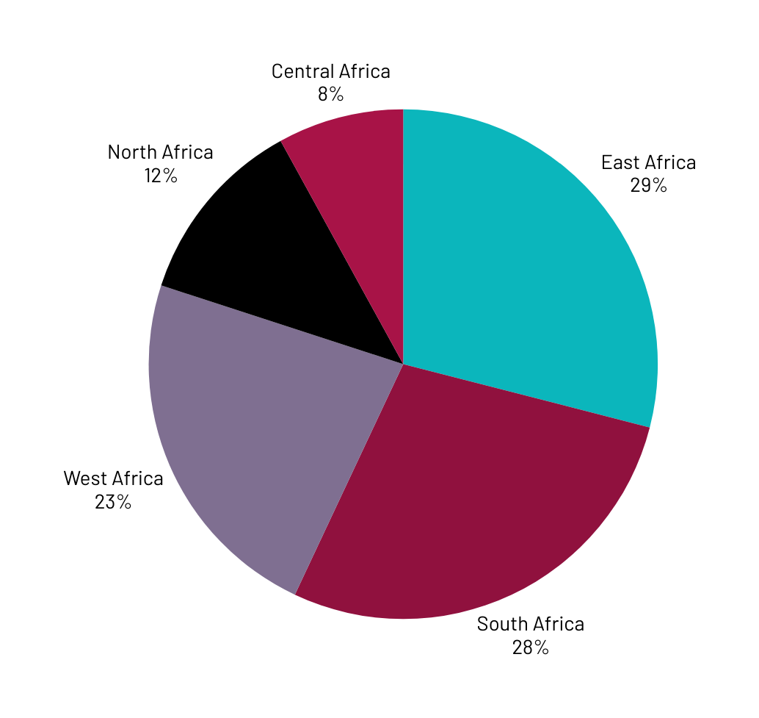
Market Size
Kenya's market is fueled by its vibrant SMB sector, which constitutes about 80% of businesses. However, these businesses face a financing gap of approximately KES 2.2 trillion ($19.3 billion).This gap highlights the demand for tools that streamline financial and inventory management.
Africa (Segmented by Region)
1. North Africa: A region with strong economic hubs like Egypt and Morocco, where SMBs are increasingly adopting digital solutions to enhance operational efficiency.
2. South Africa: Home to a well-developed SMB ecosystem, with significant demand for inventory and financial management tools to support growth.
3. East Africa: Includes Kenya, Uganda, and Tanzania, where SMBs are rapidly embracing technology to overcome financial and inventory challenges.
4. West Africa: Countries like Nigeria and Ghana are seeing a surge in SMBs seeking digital tools to manage finances and inventory effectively.
5. Central Africa: A developing market with growing interest in digital solutions, particularly in countries like Cameroon and the Democratic Republic of Congo.

Slide 7

Competitors
1. QuickBooks:
- Why ours is Better: QuickBooks focuses heavily on financial tools like bookkeeping and invoicing but doesn't integrate inventory management and profit optimization in a seamless way. Our app stands out by combining these features with a mission to empower SMB owners in Africa, addressing not just operational efficiency but also poverty alleviation.
2. Zoho Books:
- Why ours is Better: Zoho Books offers inventory tracking, but it lacks a localized approach tailored to African SMBs. Our app's focus on the specific needs of African markets, such as affordability, accessibility, and targeted insights for combating poverty, makes it a more impactful solution.
3. Xero:
- Why ours is Better: While Xero provides advanced financial and inventory tools, it’s designed primarily for larger or more established businesses in developed markets. Our app differentiates itself by being SMB-friendly, intuitive for users with minimal technical expertise, and aligned with the unique challenges faced by African entrepreneurs.
23

Slide 8

Competitive Advantage
1. Localized Focus: Tailored specifically to African markets, addressing unique challenges SMBs face in the region.
2. Comprehensive Integration: Combines financial management, profit optimization, expenditure tracking, and inventory control in a single app.
3. User-Friendly Design: Intuitive interface designed for users with varying levels of technical expertise.
4. Affordability: Priced to remain accessible to small and medium-sized business owners.
5. Social Impact Mission: Goes beyond operations to empower users by combating poverty and fostering economic growth.
6. Actionable Insights: Provides advanced analytics and reports that help SMBs make informed decisions.
7. Scalability: Designed to grow with businesses, offering flexibility for both small enterprises and those expanding their reach.
8. Accessibility: Offline functionality or minimal data requirements, ensuring usability in areas with limited internet access.
9. Holistic Financial View: Tracks and connects income, expenses, inventory, and profits seamlessly for a complete picture.
10. Local Language Support: Options for multiple African languages to enhance inclusivity and accessibility.

Slide 9
Project Traction
Tasks
January
March
April
June
August
Concept and Planning
Market Research
Design and Prototyping
Development
Testing and Refinement
Launch Strategy
Marketing and Outreach
Monitoring and Updates
23

Slide 10

Business Model
OUR BUSINESS MODEL WILL BE A FREEMIUM MODEL.
User Base: Our app will attract 100,000 users in its first year, with 10% converting to premium, we will have 10,000 paying users.
Pricing: Our subscription fee of $5 per month, will generate $50,000 monthly revenue from premium users.
Annual Revenue: This translates to $600,000 annually from premium subscriptions alone.
Costs: Subtracting development, marketing, and operational costs (i.e, $300,000 annually), will leave us with a profit of $300,000.
23

Slide 11
Go To Market
1. Referral Programs: Encourage users to invite others by offering incentives, such as discounts on premium features or extended free trials for successful referrals.
2. Digital Marketing: Use targeted online ads (Google, Facebook, Instagram) focusing on keywords like "SMB finance tools" or "inventory management Africa." Pair this with engaging social media campaigns.
3. Localized Outreach: Highlight the app’s African focus by incorporating local languages, regional case studies, and culturally relevant imagery in your branding and communication.
4. Free Trials and Freemium Entry: Attract users with a free version that provides basic functionality while showcasing the value of premium features to upsell.

Slide 12
Social Impact
1. No Poverty: The app helps combat poverty through increased profitability and sustainable growth.
2. Decent Work and Economic Growth: Encourages entrepreneurship and supports small businesses, driving economic growth.
3. Reduced Inequalities: Provides tools and resources tailored for SMBs in underserved regions.
4. Industry, Innovation, and Infrastructure: Promotes the use of innovative technology to improve SMB operations and build resilient businesses across Africa.

Slide 13
Our Ask
We are seeking $30,000 to develop MaliTrack, an app that empowers SMBs in Africa by offering tools for financial management, inventory tracking, and profit optimization.
Spending:
App Design and Development: $18,000
Testing and Bug Fixes: $3,000
Marketing and Outreach: $5,000
Launch Strategy Execution: $2,000
Operational Costs: $2,000
Total : 30,000

Slide 14
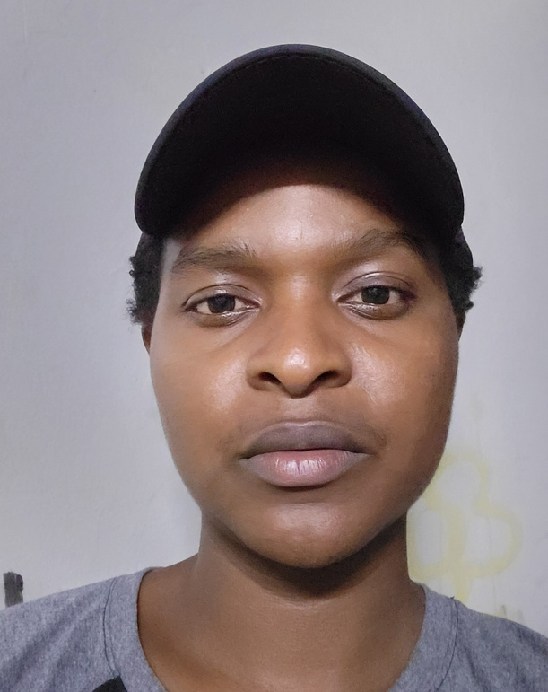


Team Members
SOLOMON KURIA
PETER MACHARIA
CHRISTINE WANJIKU
CEO & LEAD DEVELOPER
CO - FOUNDER & CTO
Chief Marketing Officer.

Slide 15



Thank you!
mpeter778@gmail.com ||| https://MaliTrack.io
17

